Slide 1
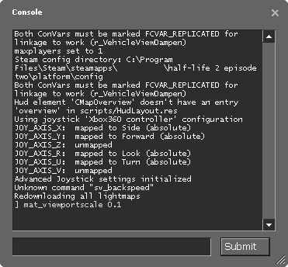
1.3 Console Input And Output
academy.zariba.com

Slide 2
Lecture Content
Printing on the Console
Reading from the Console

Slide 3


1. Printing on the Console
Printing numbers.
Printing more variables using formatting strings.

Slide 4
Formatting Strings
The formatting string looks like this:
{placeholder index[,alignment][:formatString]}
e.g. {0,20:F3}
There are different types of formatStrings:
“0.00” - floating
C - currency
D – decimal
E – exponential (scientific)
F – fixed point
G – general
N - number
P - percentage
R – round Trip
X - hexadecimal

Slide 5

2. Reading from the Console
Reading a character.
Reading a line.
Reading keys.

Slide 6
Console.Read();
Reads a single character from the console, after pressing enter.
Returns an integer.
To obtain a character we need to perform a type casting.

Slide 7
Console.ReadKey();
Reads a combination of keys from the keyboard.
The result is of type ConsoleKeyInfo.
KeyChar – holds the key entered
Modifiers – holds the modifiers information, e.g. ctrl

Slide 8
Console.ReadLine();
Reads a single line of characters.
The result is of type string.
To read integers we need to convert (parse) the string to an integer value.

Slide 9
Homework
1. Write a program that reads two positive integer numbers and prints how many numbers p exist between them such that the reminder of the division with p by 5 is 0 (inclusive). Example: p(17,25) = 2
2. Write a program that gets two numbers from the console and prints the greater of them. Don’t use if statements.
Write a program that reads the coefficients a, b and c of a quadratic equation ax²+bx+c=0 and solves it (prints its real roots).
Write a program that gets a number n and after that gets more n numbers and calculates and prints their sum.
Write a program that reads an integer number n from the console and prints all the numbers in the interval [1..n], each on a single line.

Slide 10

References

Slide 11



Zariba Academy
Questions

